Slide 1

COP 6731: Theory and Implementation of Database Systems
Recovery

Slide 2
Recovery
Restore the database to the most recent consistent state before the time of failure.
System Log: the system must keep information about the changes to data items.
Write-ahead logging (WAL): The log must be recorded into the disk before changes are applied to the database.
Checkpoint: A checkpoint writes the current in-memory modified pages (known as dirty pages) and transaction log information from memory to disk and, also, records information about the transaction log.

Slide 3
Recovery
A log file contains before and after-images of updates to the database. Before images can be used to undo changes to the database (i.e., perform backward recovery); after-images can be used to redo changes (i.e., perform forward recovery).
Write-ahead log protocol ensures that log records are written before the corresponding write to the database. If the system fails before the write occurs after the log record has been written but before the write to the database, the system can recover using the information in the log file.
Log file also contains a checkpoint record, which can speed up the time for recovery following a failure.

Slide 4
Handling the Buffer Pool
No Steal
Steal
Force
Trivial
No Force
Desired
Force every write to disk?
Poor response time.
But provides durability.
Steal buffer-pool frames from uncommitted transactions?
If not, poor throughput.
If so, how can we ensure atomicity?

Slide 5
More on Steal and Force
STEAL (why enforcing Atomicity is hard)
To steal frame F: Current page in F (say P) is written to disk; some transactions hold a lock on P.
What if the transaction with the lock on P aborts?
Must remember the old value of P at steal time (to support UNDOing the write to page P).
NO FORCE (why enforcing Durability is hard)
What if a system crashes before a modified page is written to disk?
Write as little as possible, in a convenient place, at commit time, to support REDOing modifications

Slide 6
Basic Idea: Logging
Record REDO and UNDO information, for every update, in a log.
Sequential writes to log (put it on a separate disk).
Minimal info (diff) written to the log, so multiple updates fit in a single log page.
Log: An ordered list of REDO/UNDO actions
Log record contains:
<XID, pageID, offset, length, old data, new data>

Slide 7
Write-Ahead Logging (WAL)
The Write-Ahead Logging Protocol:
Must force the log record for an update before the corresponding data page gets to disk.
Must write all log records for a transaction before committing.
#1 guarantees Atomicity.
#2 guarantees Durability.
Exactly how is logging (and recovery!) done?
We’ll study the ARIES algorithms.

Slide 8
Checkpointing
Periodically, the DBMS creates a checkpoint, in order to minimize the time taken to recover in the event of a system crash. Write to log:
begin_checkpoint record: Indicates when the checkpoint begins.
end_checkpoint record: Contains current transaction table and dirty page table.

Slide 9
Recovery
UNDO type log includes the new value.
REDO type log includes the old value.
UNDO and REDO operations are required to be idempotent.
Idempotence is the property of certain operations in mathematics and computer science whereby they can be applied multiple times without changing the result beyond the initial application.

Slide 10
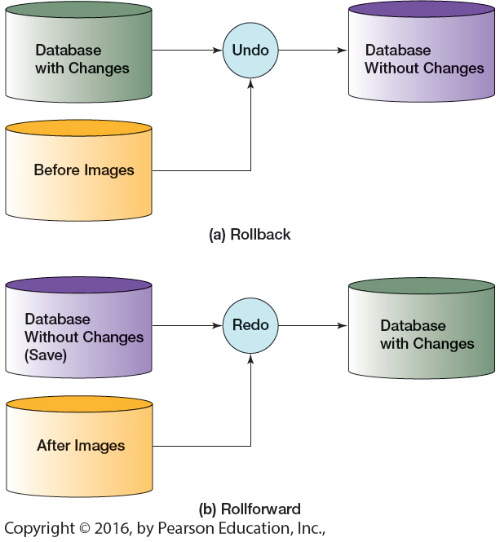
Recovery

Slide 11
Deferred Update (NO-UNDO/REDO)
The updates are recorded only in the log and in the cache buffer.
A transaction does not reach its commit point until all its REDO-type log entries are recorded in the log and the log buffer is force-written to disk (i.e., WAL).
After the transaction reaches its commit point and the log is force-written to disk, the updates are recorded in the database.
Only REDO type log entries are needed in the log (i.e., UNDO are not needed)
This is not practical when a transaction is long and it changes many items.

Slide 12
Deferred Update (NO-UNDO/REDO)
Use two lists of transactions
commit list: the committed transactions since the last checkpoint
active list: the active transactions
REDO all the WRITE operations of the committed transactions.

Slide 13
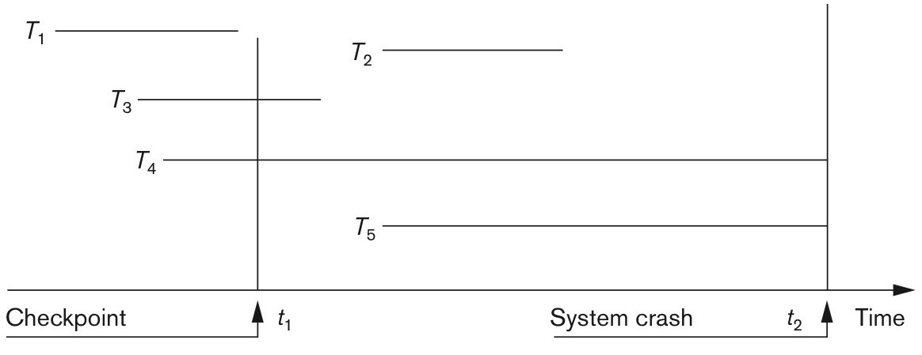
Deferred Update (NO-UNDO/REDO)

Slide 14
Deferred Update (NO-UNDO/REDO)
NO-UNDO/REDO with strict two-phase locking
This ensures strict and serializable schedules.
A transaction never read the value of an item that is written by an uncommitted transaction.

Slide 15
Log File Format
operations
transaction id
data item
before image(BFIM)
after image(AFIM)

Slide 16
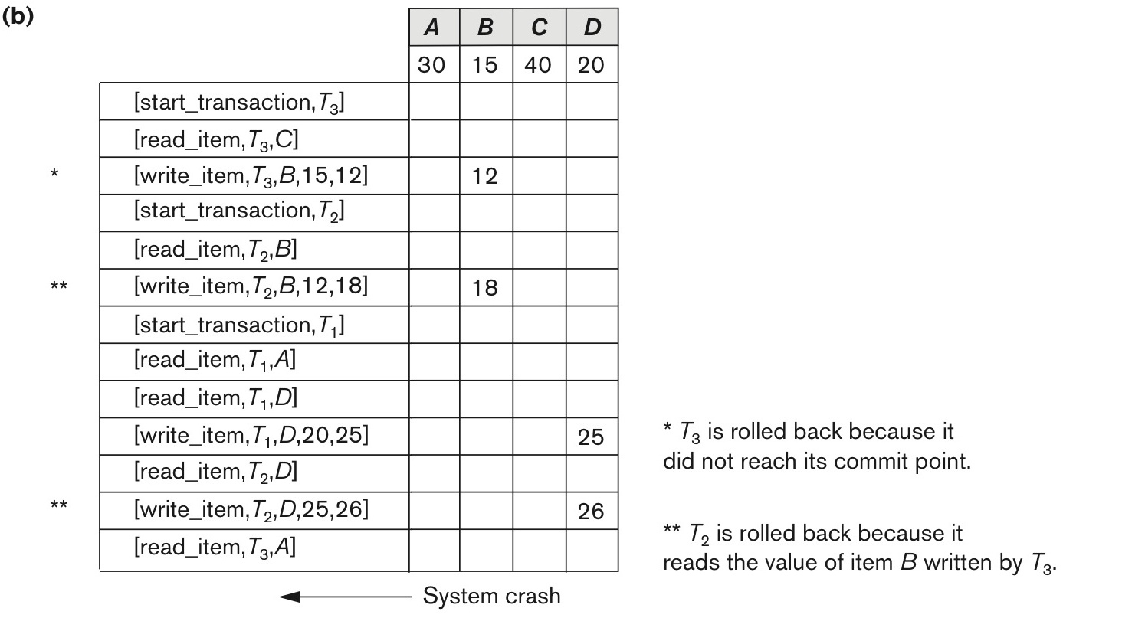
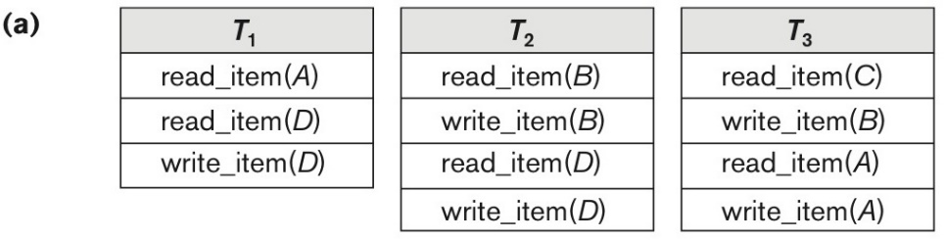
Example of deferred update

Slide 17

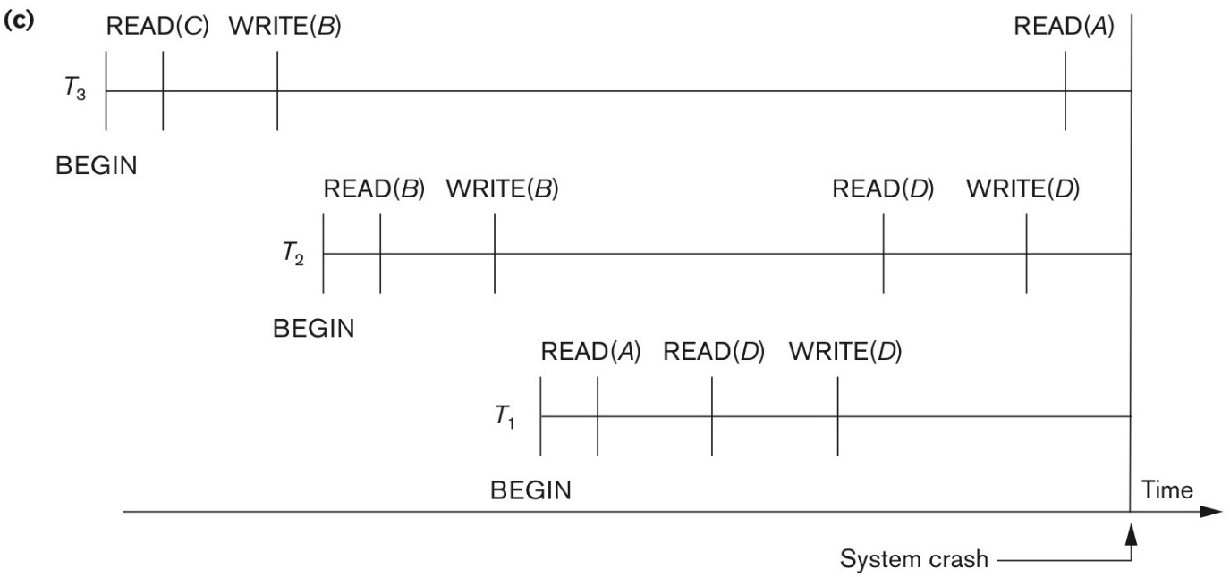
Example of deferred update

Slide 18
Immediate Update (UNDO/NO-REDO)
All updates of a transaction are recorded in the database on disk before the transaction commits.

Slide 19
Immediate Update (UNDO/NO-REDO)
Only write_item operations need to be undone during transaction rollback.
read_item operations are recorded in the log only to determine whether cascading rollback of additional transactions is necessary.

Slide 20
UNDO/REDO
If the transaction is allowed to commit before all its changes are written to the database, we must consider UNDO/REDO.
This is most used in practice (e.g., ARIES)
Use two lists of transactions: commit list and active list.
UNDO all the WRITE operations of the active transactions (active list).
REDO all the WRITE operations of the committed transactions (commit list).

Slide 21
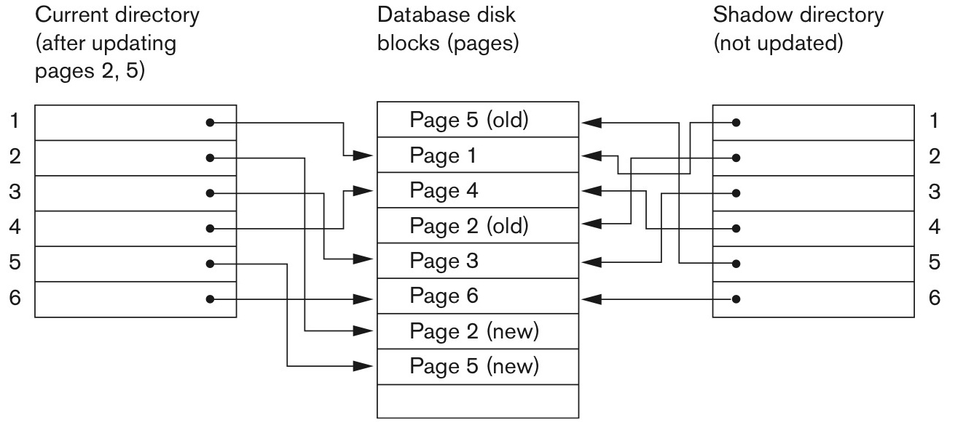
Shadow Paging
When a transaction begins, the current directory is copied into a shadow directory. Then the shadow directory is saved on disk while the current directory is used by the transaction.

Slide 22
ARIES
UNDO/REDO recovery algorithm
There are three main concepts:
write-ahead logging (WAL)
repeating history during REDO
logging changes during UNDO
ARIES consists of three main steps: Analysis, REDO, and UNDO.
Analysis step identifies the dirty (updated) pages and the set of active transactions.
REDO re-applies updates from the log to the database.
UNDO scans the log backward and applies “undo” to all active transactions in reverse order.

Slide 23
ARIES
ARIES requires log, transaction table, dirty page table.
Every log record has a log sequence number (LSN).
A log record is written for any of the following actions:
write (i.e., update)
commit
abort
undo
end of the transaction

Slide 24
Crash Recovery: Big Picture
Oldest log rec. of transaction active at crash
Start from a checkpoint (found via master record).
Three phases. Need to:
Figure out which transactions were committed since checkpoint, which failed (Analysis).
REDO all actions.
(repeat history)
UNDO effects of failed transactions.
Smallest recLSN in dirty page table after Analysis
Last checkpoint
CRASH
A
R
U

Slide 25
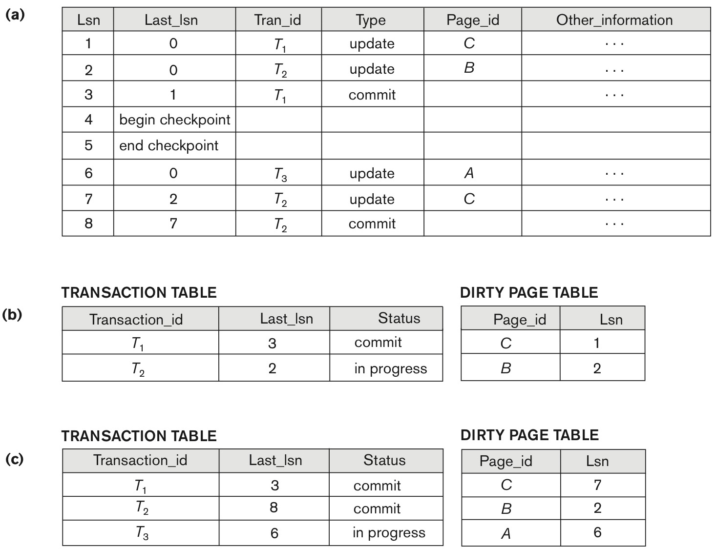
ARIES

Slide 26
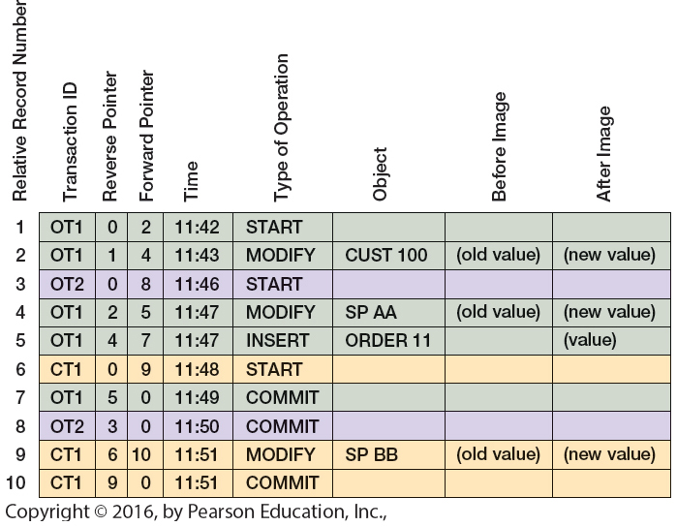
ARIES

Slide 27
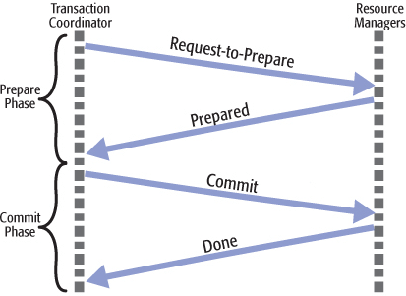
Two Phase Commit Protocol
Two-phase commit protocol (2PC) coordinates all the processes that participate in a distributed atomic transaction on whether to commit or abort (rollback) the transaction. It is not resilient to all possible failure configurations, and in rare cases, manual intervention is needed to remedy an outcome.

Slide 28
Take home message
Recovery algorithms
UNDO/REDO
Shadow Page
ARIES

